Slide 1
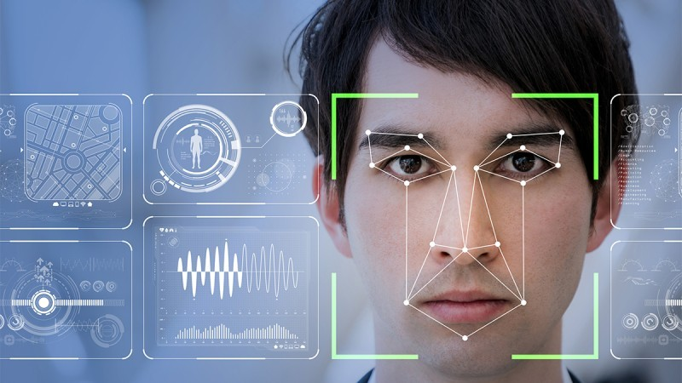
Face Recognition Based Attendance System

Slide 2

ABSTRACT:
The Face Recognition Based Attendance System is an automated solution that replaces traditional manual attendance recording methods with a computer vision-based approach. The system uses facial recognition technology to identify individuals, mark their attendance in real-time, and maintain digital records in a database. It aims to eliminate issues like proxy attendance, manual errors, and time consumption associated with conventional attendance systems while providing a contactless, efficient, and accurate alternative suitable for educational institutions and organizations.

Slide 3
INTRO OF PROJECT:
This project implements an automated attendance management system using facial recognition technology. Traditional attendance systems like paper-based registers or biometric fingerprint scanners have various limitations including time consumption, proxy attendance, and hygiene concerns.
The proposed system uses computer vision and deep learning techniques to recognize faces from a camera feed, match them against a database of registered users, and automatically record attendance with timestamps. The solution consists of a user interface for administration, a database for data storage, and the core facial recognition module.
INPUT
RECOGNITION
DATABASE
DETECTION

Slide 4
EXISTING SYSTEM/METHOD:
Manual Paper-Based Systems
ID Card or RFID-Based Systems
Biometric Systems
PIN/Password-Based Systems
PROPOSED METHOD:
Face Detection
Face Recognition
Database Integration
User Interface
Automated Reports

Slide 5
Technologies
Used:
OpenCV: An open-source computer vision library used for image and video processing tasks, such as capturing frames from video streams and detecting faces within those frames.
Dlib: A toolkit containing machine learning algorithms, including robust facial landmark detection and face recognition capabilities.
Python: A versatile programming language with extensive libraries and community support, making it suitable for rapid development and integration of AI and machine learning solutions.

Slide 6
Applications of the Project:
This technology is applicable in various settings, including:
Educational Institutions: Automating student attendance in classrooms and lecture halls.
Corporate Environments: Monitoring employee attendance in offices and workplaces.
Events and Conferences: Registering and tracking participants efficiently.

Slide 7
Key Considerations for the Project:
Accuracy of Recognition
Data Privacy and Security
User Consent
Environmental Adaptability
Scalability

Slide 8
Operational Workflow:
Data Acquisition: Capture images or video frames of individuals entering a designated area using a camera.
Face Detection: Utilize a face detection algorithm (e.g., Haar Cascades, HOG) to locate faces within the captured frames.
Feature Extraction: Analyze detected faces to extract unique facial features, creating a distinctive numerical representation for each face.
Face Recognition: Compare extracted features against a pre-existing database to identify individuals.
Attendance Logging: Record the identified individual's presence in the attendance system, updating records accordingly.

Slide 9
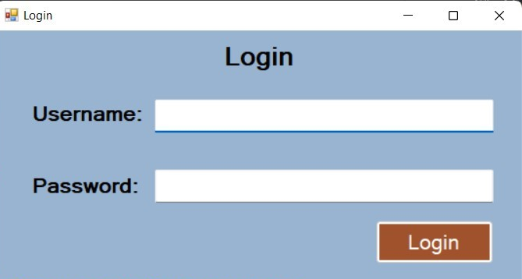
Login Screen:

Slide 10
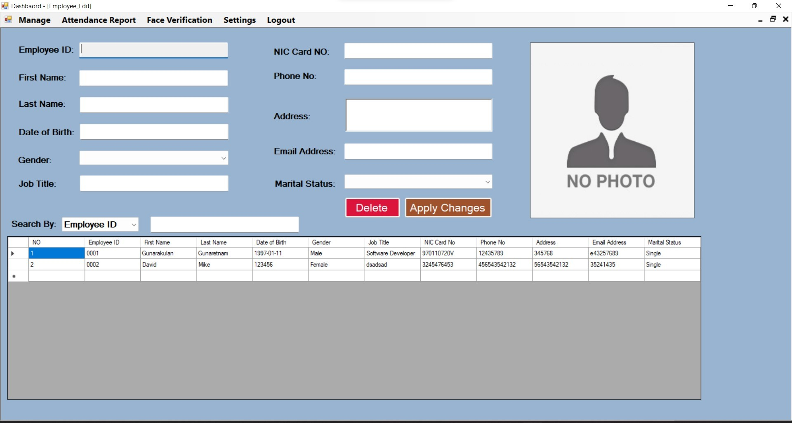
Manage Employees (Insert Employees Module):

Slide 11
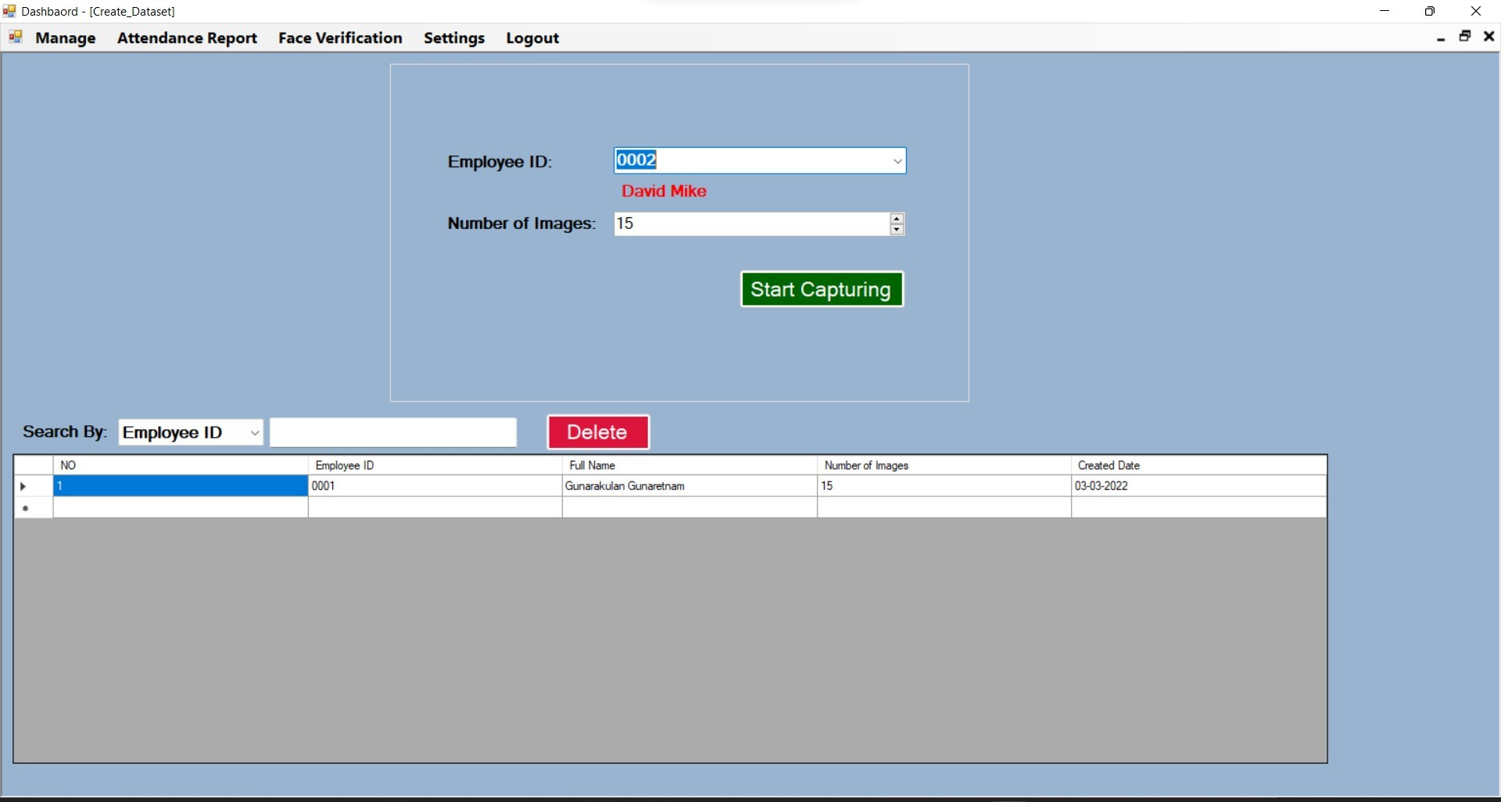
Create Dataset:

Slide 12
Training:

Slide 13
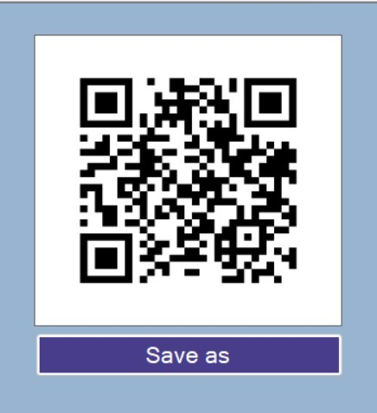
Generate QR Code
After the training finishes, the system will automatically generate a QR-Code for that particular employee, this QR-Code will be printed in the employee's ID card.

Slide 14
1)Haar Cascade Classifier:
Used for face detection in images and video frames
Works by analyzing contrasting pixel intensities to identify facial features
Employs integral images for fast feature evaluation and AdaBoost for classifier training
Implementation through OpenCV’s (cv2.CascadeClassifier) with the pre-trained model
haarcascade_frontalface_default.xml
ALGORITHMS USED AND DESCRIPTION:
2)LBPH (Local Binary Pattern Histogram):
Used for face recognition after faces are detected
Process:
Divides the image into grids
For each pixel, compares it with neighbors to generate binary patterns
Creates histograms of these patterns
Uses these histograms as feature vectors to identify faces
Advantages: Rotation invariance, illumination invariance, and computational simplicity
Implementation through OpenCV’s (cv2.face.LBPHFaceRecognizer_create())

Slide 15
libraries and their purposes:
Python 3.6
The project is built to run on Python 3.6 for compatibility with specific library versions.
2.opencv-python==4.5.5.62
Provides computer vision tools for face detection, image capture, and video processing.
3.pyttsx3==2.90
Text-to-Speech (TTS) conversion.
4. cmake==3.22.2
Build and compile essential C/C++ extensions for some Python libraries (e.g dlib).
5.face_recognition==1.3.0
Essential for recognizing faces and comparing them to the stored dataset.
6.imutils==0.5.4
Helper functions for image processing tasks like resizing, rotating, and displaying images.
7. playsound==1.2.2
Play audio files (.mp3, .wav) directly from Python.
8. mysql-connector-python==8.0.28
Connects Python to a MySQL database for storing and retrieving attendance records.
9. qrcode==7.3.1
Generate QR codes.

Slide 16
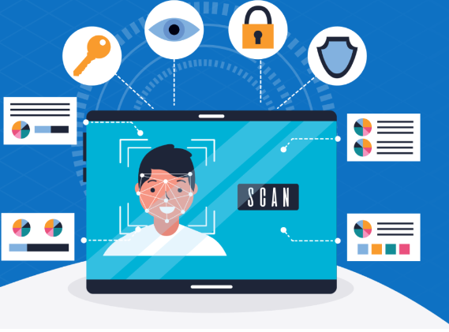
FUTURE SCOPE:
Advanced Recognition Techniques:
Implementation of deep learning models (CNN, FaceNet, etc.) for improved accuracy
Integration with more sophisticated algorithms like ArcFace or FaceNet
Expanded Functionality:
Mobile application interface for remote attendance
Cloud integration for centralized data management
Multi-location support for distributed campuses/offices
Integration with existing ERP/LMS systems
Security Enhancements:
Liveness detection to prevent spoofing (using printed photos)
Encryption of facial data and attendance records
Two-factor authentication for heightened security
User Experience Improvements:
Web-based interface for cross-platform access
Responsive design for different devices
Real-time notifications and alerts
Customizable reporting dashboards
Technical Improvements:
Optimization for low-resource environments
Supporting multiple camera inputs
Mask detection and adaptation for health safety

Slide 17
CONCLUSION:
The Face Recognition Based Attendance System successfully addresses the limitations of traditional attendance methods by providing an automated, contactless, and efficient solution. By leveraging computer vision techniques like Haar cascades for detection and LBPH for recognition, the system demonstrates the practical application of artificial intelligence in solving everyday administrative challenges.
The implementation in Python with OpenCV offers a balance between complexity and performance, making it accessible for educational and organizational environments. The integration with a database ensures data persistence and enables comprehensive reporting capabilities.
While the current system fulfills its core objective of automating attendance recording, there remains significant potential for enhancement through more advanced algorithms, expanded features, and integration with existing systems. The project serves as a foundation for exploring computer vision applications in administrative processes and demonstrates the feasibility of replacing manual systems with automated, AI-driven solutions.

Slide 18
TEAM MEMBERS:
MARNI SAI LAKSHMI SARANYA
TATA SAI PRASANNA
SARISA KOMALI
ANAMADEVARA SAI LAKSHMI
KASA SRIVALLI

Slide 19
THANK YOU

